Slide 1
SAP BTP CLD500 Training
Day 2
Anubhav Oberoy
www.AnubhavTrainings.com
Follow excellence with sheer passion

Slide 2

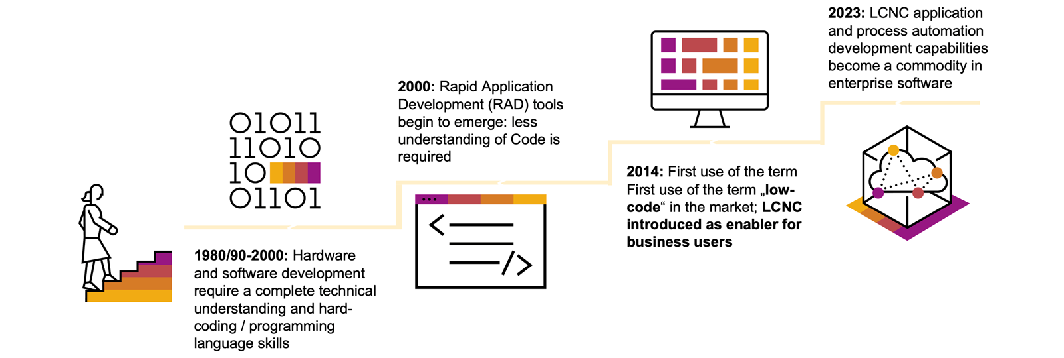
Low-Code / No-Code Technology
The evolution of coding can be traced back to the 1950s, when the first programming languages were created to communicate instructions to a computer. By the 1980s, software development was becoming an important business competency following rigorous knowledge and practices until the end of the century.
Now, after twenty more years of evolution, the emergence of visual programming tools, application programming interfaces with integrations, and the platform economy have democratized development.
www.anubhavtrainings.com

Slide 3
Low Code v/s No Code
Low-code and no-code (LCNC) refer to a new style of visual programming that makes it possible to develop applications without the use of coding languages, which greatly reduces the barrier of entry for anyone looking to take up application development. To differentiate between the two aspects:
Low-code uses both a traditional programming language-based environment combined with no-code platforms and is used by developers with at least basic technical knowledge.
No-code is simpler, and it fully replaces the traditional programming language-based tooling with a suite of visual development tools (ex. drag-and-drop components) and can be used by technical and non-technical people alike, such as citizen developers.
On the other end of the spectrum, you have the most complex work, the traditional software development where high-level programming knowledge and professional development experience is required to build applications and automations that solve nuanced problems.
www.anubhavtrainings.com

Slide 4
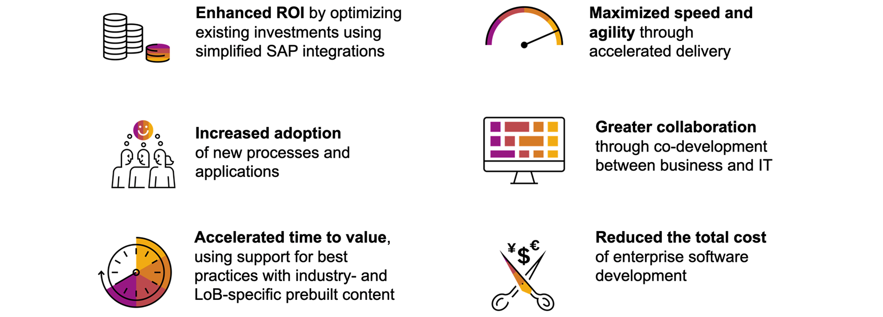
Advantages of Low-Code / No-Code Platforms
www.anubhavtrainings.com

Slide 5
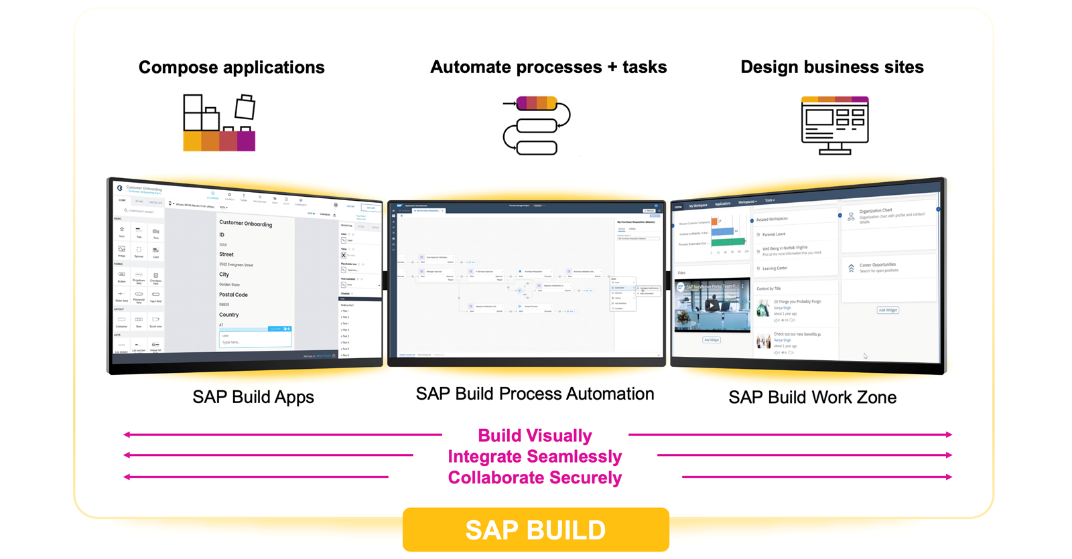
SAP Build for Citizen Developers
www.anubhavtrainings.com

Slide 6
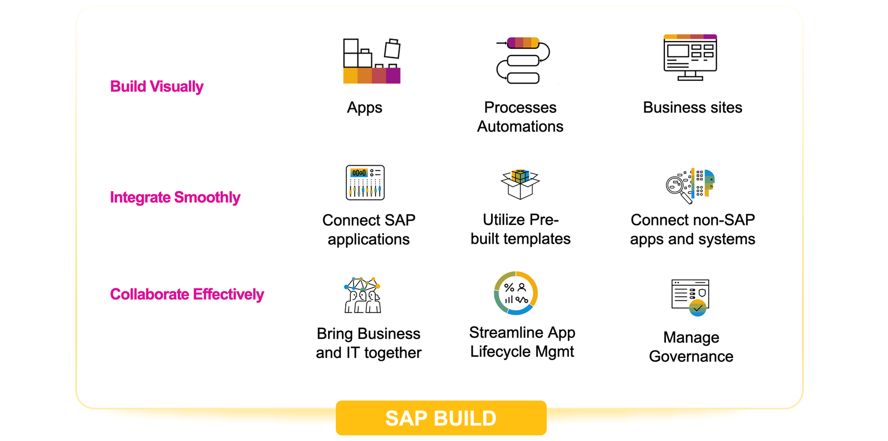
Key Advantages
www.anubhavtrainings.com

Slide 7
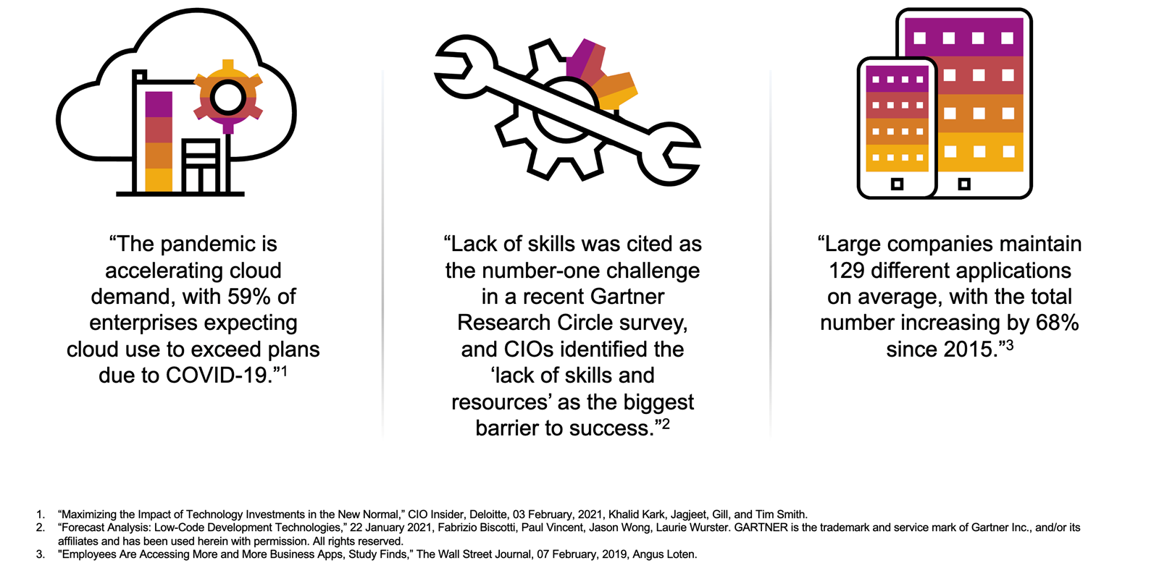
Introduction to Problem Solving With LCNC and Citizen Development
www.anubhavtrainings.com

Slide 8
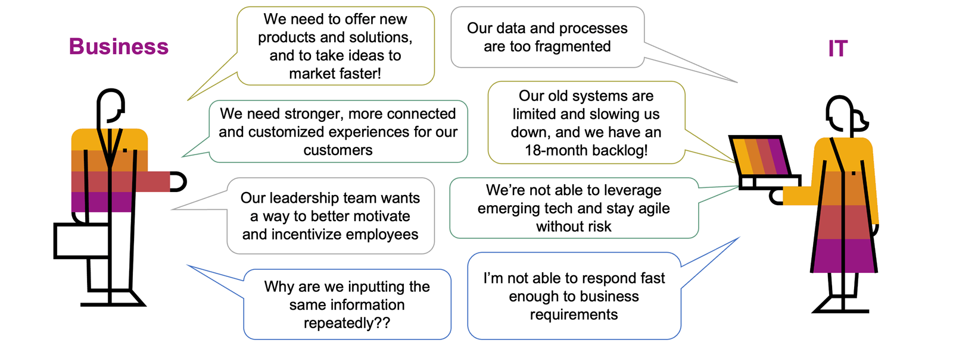
Solving Problems with LCNC and Citizen Development
www.anubhavtrainings.com

Slide 9
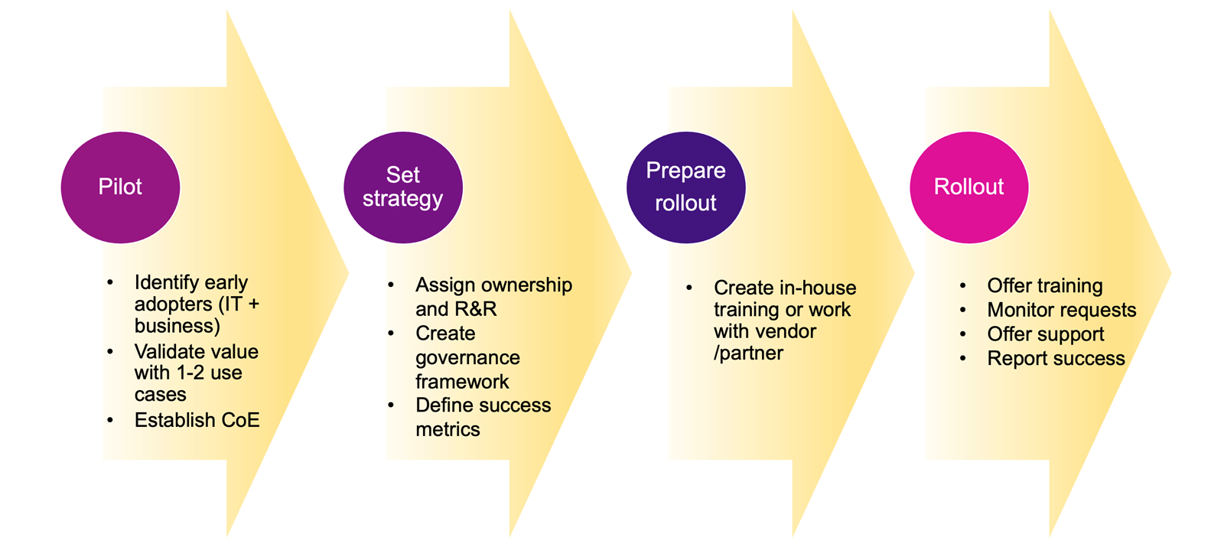
Rolling Out of Citizen Development in Your Organization
www.anubhavtrainings.com

Slide 10
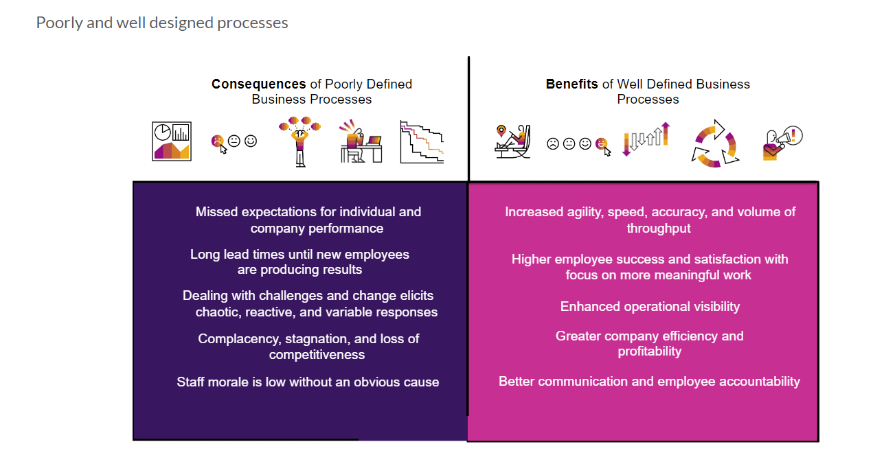
What is Business Process and BPM
In big organizations the large number of employees can only be managed when we have pre-defined, standardized processes. Processes in each area like leave request/approval, SRM purchasing, Order-to-cash, order approval, maintenance contract preparation, procure-to-pay, hiring.
Business process is the heart of an ERP system and a software which manages such business processes is called BPM.
It is in the best benefit of a company to comply to business process is to automate the same.
First, let’s clarify why businesses need Business Process Management Software (BPMS) like SAP Build Process Automation. In a company running thousands of processes, it can be challenging for management to see where things are going wrong. In the end, it all comes down to how well business processes can be defined and executed. Business Process Management Software helps you to bring structure into the large amount of your company’s business processes. It helps to prevent potential chaos and to clearly define and manage the processes. Let’s have a look at the consequences that poorly defined business processes mean for your company, and which benefits well-defined business processes offer.
www.anubhavtrainings.com

Slide 11
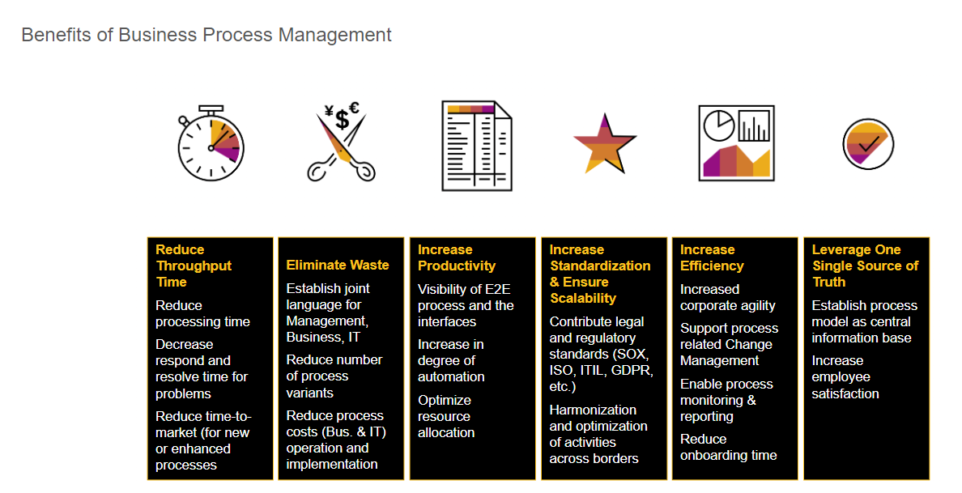
What is Business Process Management?
Business Process Management (BPM) is an approach used to identify, analyze, measure, and improve an organization’s processes. BPM is not to be seen as just another software in your company, but rather as a strive for operational excellence. It helps a company run faster, better, and at a lower expense, too.
www.anubhavtrainings.com

Slide 12
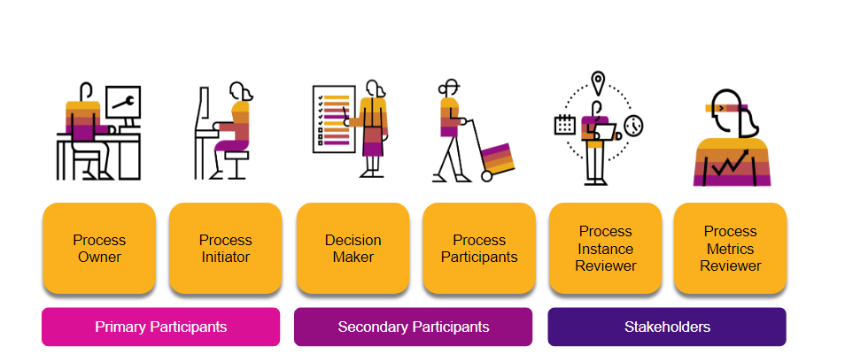
Roles Involved in Business Processes
The key roles involved in a business process can be categorized into three different groups: Primary Participants, Secondary Participants, and Stakeholders. The following example - Roles involved in a Laptop Ordering Process - provides a simple overview.
Process Owner
Is overall, responsible for a process from the business perspective. Needs to trigger process adjustments when something does not run smoothly.
Process Initiator
Starts the process by performing an action. This can happen knowingly or unknowingly.
Decision Maker
Is responsible for taking decisions that influence the direction of the process. Approvals or rejections naturally lead to different process outcomes.
Process Participants
Need to perform certain tasks within the process. These can be physical tasks or tasks performed within software systems.
Process Instance Reviewer and Process Metrics Reviewer
Has a particular interest in certain process runs or the overall process metrics due to their job description.
www.anubhavtrainings.com

Slide 13
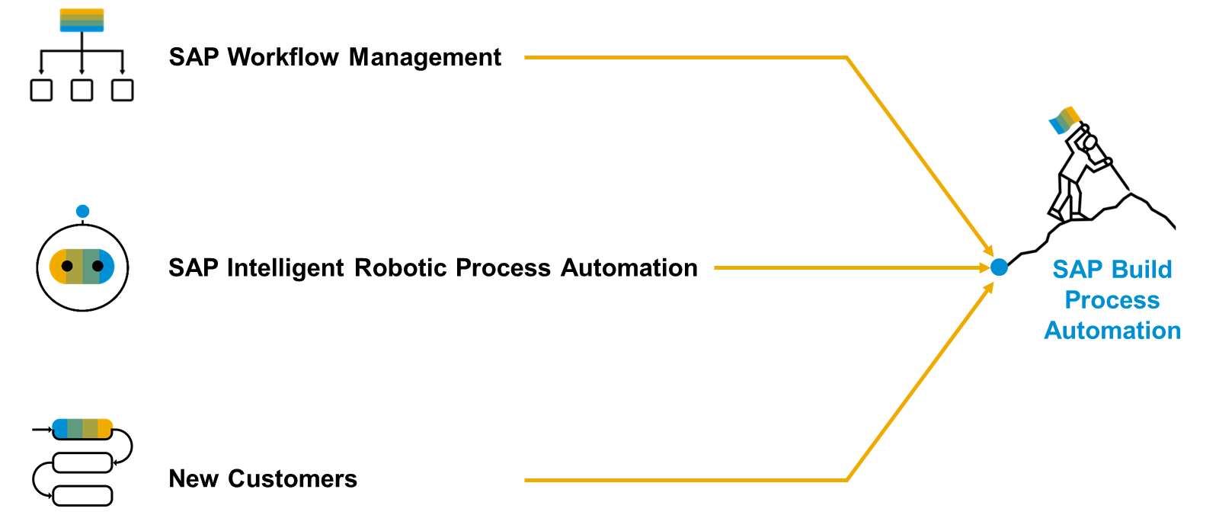
SAP Build Process Automation
www.anubhavtrainings.com
Notes:
SAP Build Process Automation is a solution that evolved out of the former stand-alone SAP products - SAP Workflow Management and SAP Intelligent Robotic Process Automation. It provides a new citizen developer experience that didn't exist in either of the two former products. As you or your company might have used SAP Workflow Management or SAP Intelligent Robotic Process Automation in the past, you are looking for a path into the joined solution. Fortunately, SAP Build Process Automation is fully compatible with all workflow and automation artifacts that you have created.

Slide 14
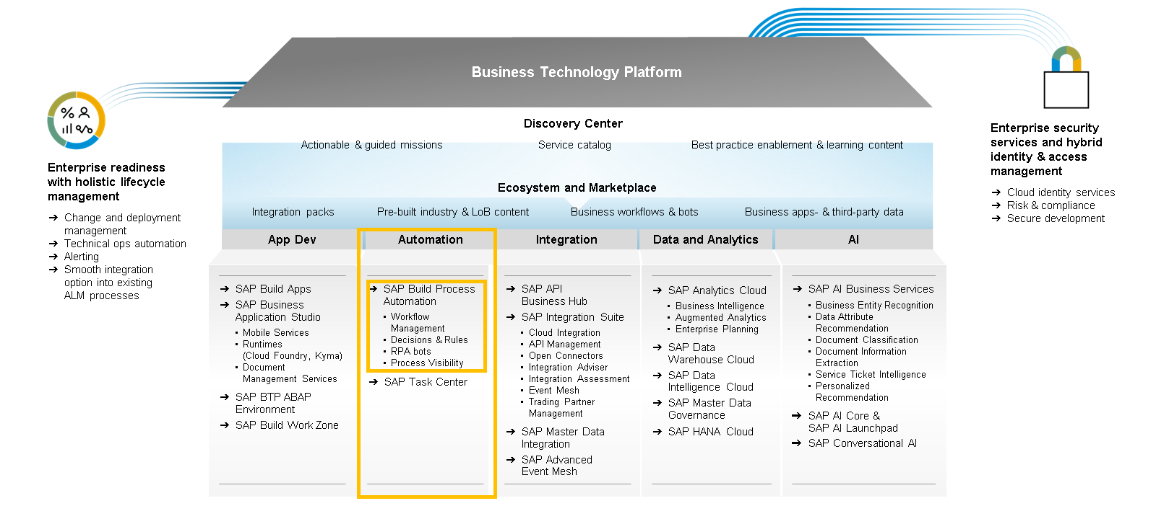
SAP Build Process Automation runs on SAP Business Technology Platform
Content
www.anubhavtrainings.com
Notes:
SAP Build Process Automation runs on SAP Business Technology Platform, so citizen developers can operate confidently with a trusted, enterprise-grade multi-cloud platform taking care of security, authorization, governance, and monitoring.
Furthermore, there’s an integration between SAP Signavio and SAP Build Process Automation that enables over 135 tailored process improvement recommendations to be automatically triggered and executed for continuous process monitoring optimization.
Finally, SAP Build Process Automation users can now automate Google Workspace applications in their processes, i.e., extract and change data from Google Sheets, retrieve dates from Google Calendar and automatically upload files to Google Drive.

Slide 15
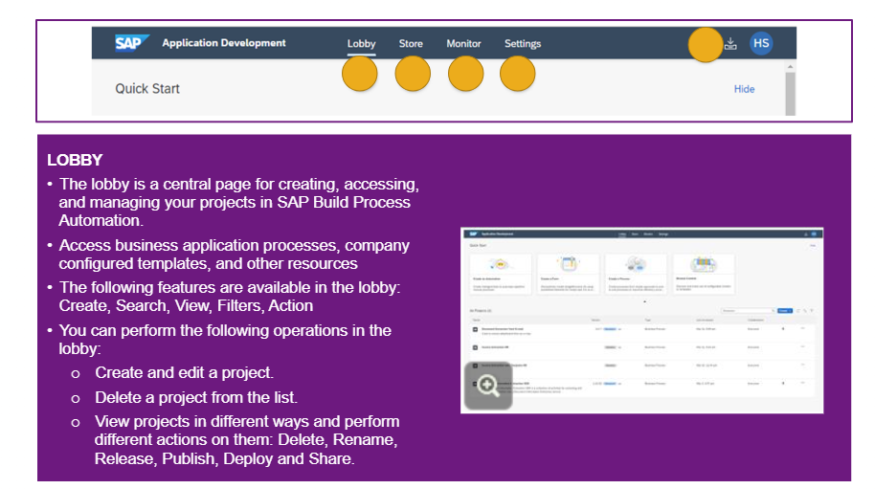
Snapshot of SAP Build Process Automation
Use the project lists view of SAP Build Process Automation in the Lobby to review existing or create new projects. Refresh, reorder, filter by type or collaborators, and complete actions such as releasing, publishing, and sharing.
From there, you can open any project and work with the capabilities, including the:
Store: with pre-built process automation content.
Monitoring: where you can look after automations and events.
Settings: where you can check the details of deployed projects and configure agents.
My Inbox: the place for you to process tasks from desktop or mobile device.
www.anubhavtrainings.com

Slide 16
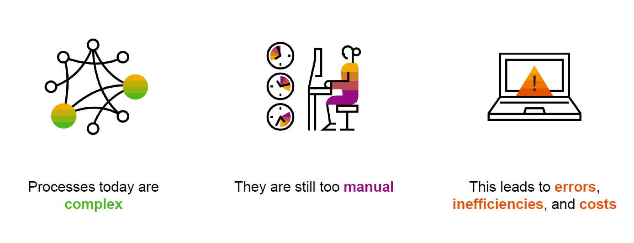
Processes run the world But…
www.anubhavtrainings.com

Slide 17
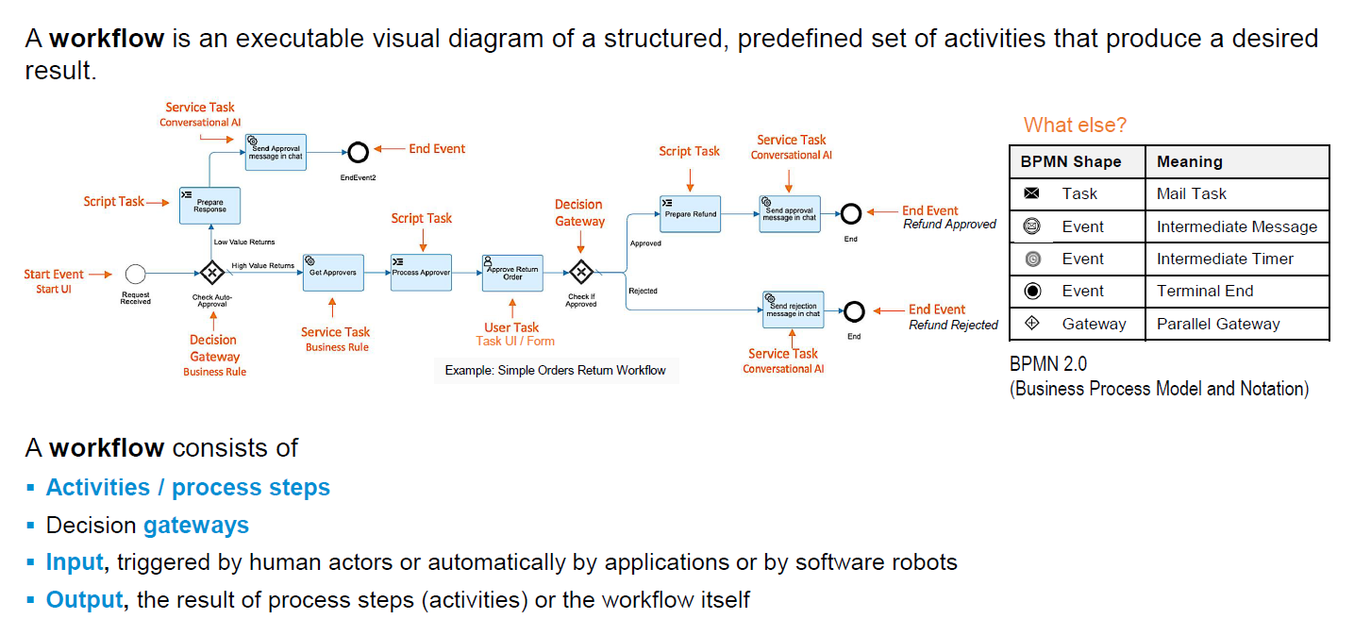
What is workflow?
Content
www.anubhavtrainings.com

Slide 18
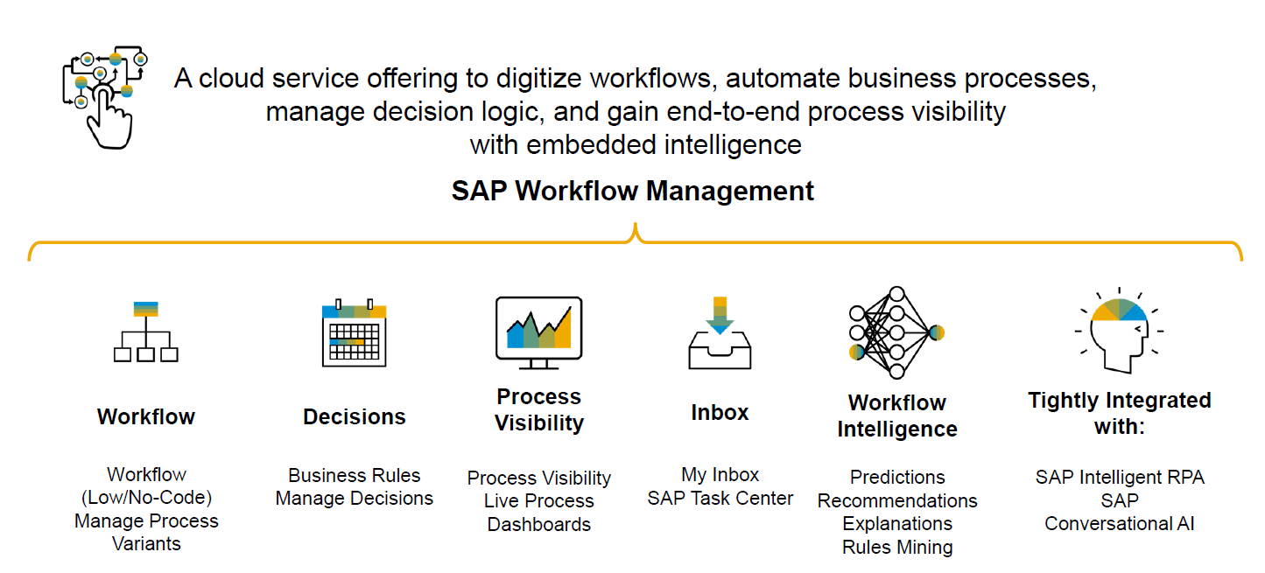
Workflow management
Content
www.anubhavtrainings.com

Slide 19
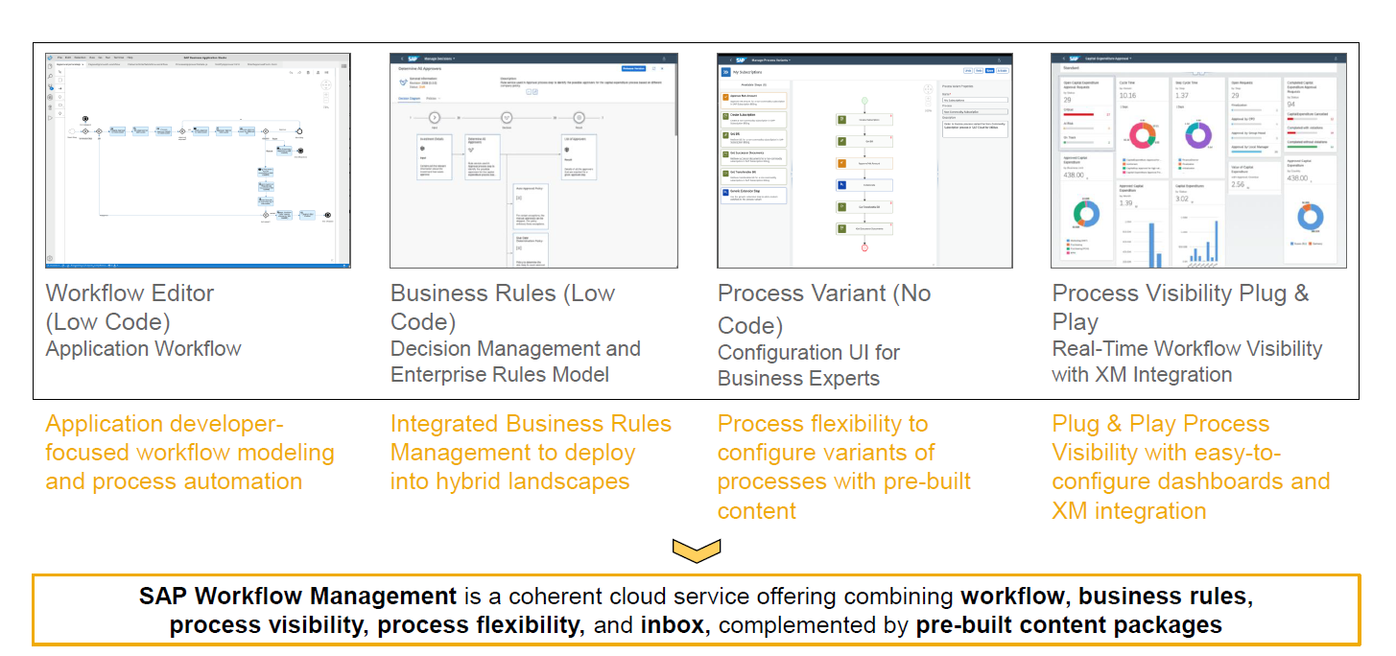
Service offerings
Content
www.anubhavtrainings.com

Slide 20
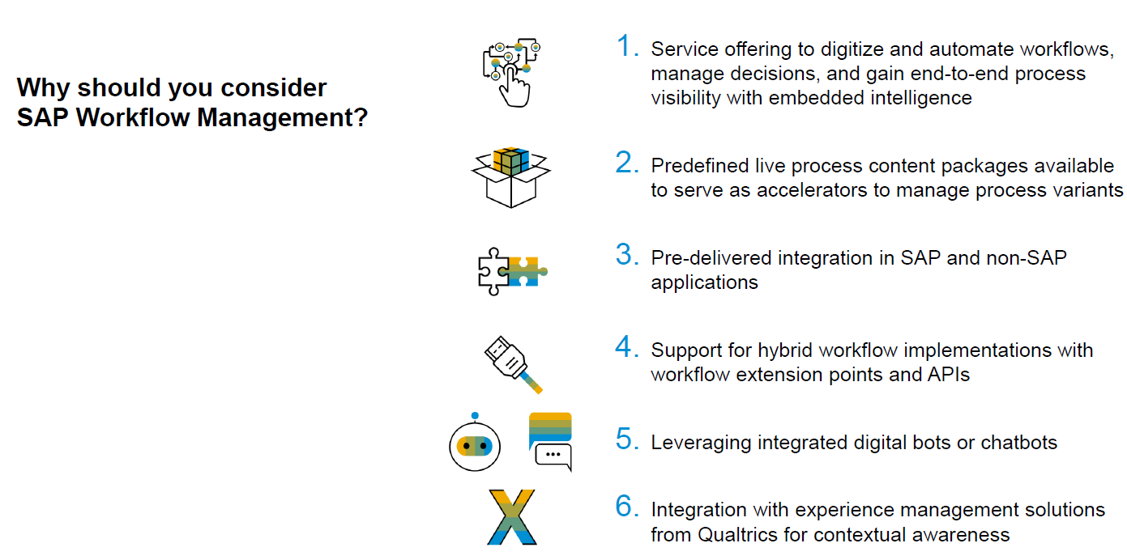
Why SAP BTP WM?
Content
www.anubhavtrainings.com

Slide 21
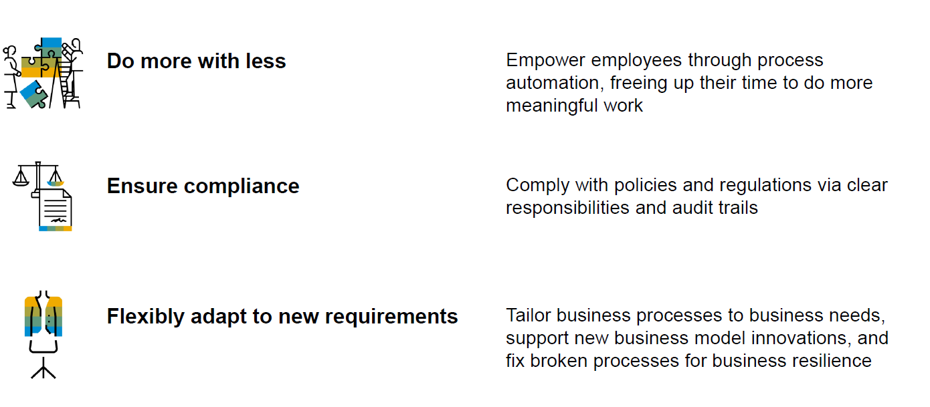
Key Benefits
Content
www.anubhavtrainings.com

Slide 22
Setup SAP Build Process Automation
Following are the steps to setup
Subscribe the SAP Build Process Automation Service
Subscribe SAP Build workzone
Setup Process Automation instance - https://help.sap.com/docs/build-process-automation/sap-build-process-automation/create-space-and-service-instance
Create Service key - https://help.sap.com/docs/build-process-automation/sap-build-process-automation/create-service-key-for-sap-build-process-automation-instance
Assign Roles to your user - https://help.sap.com/docs/build-process-automation/sap-build-process-automation/assign-sap-build-work-zone-roles-to-users
Create destination using service key - https://help.sap.com/docs/build-process-automation/sap-build-process-automation/configure-sap-build-process-automation-destinations
Import Workflow My Inbox tile to SAP Build WorkZone
Setup Dev space for Workflow development in BAS
https://help.sap.com/docs/build-process-automation/sap-build-process-automation/initial-setup
www.anubhavtrainings.com

Slide 23
Title
Content
www.anubhavtrainings.com

Slide 24
What is workflow?
Content
www.anubhavtrainings.com

Slide 25
Workflow management
Content
www.anubhavtrainings.com

Slide 26
Why SAP BTP WM?
Content
www.anubhavtrainings.com

Slide 27
Key Benefits
Content
www.anubhavtrainings.com

Slide 28
Create a Simple Workflow – Scenario 1
Design and develop a workflow to request a leave for employee.
Input
Employee ID, Reason for leave and Number of days, Start date
Workflow Steps
A work item is created for approval (currently same user)
Workflow End
Print the Result in workflow log
www.anubhavtrainings.com

Slide 29
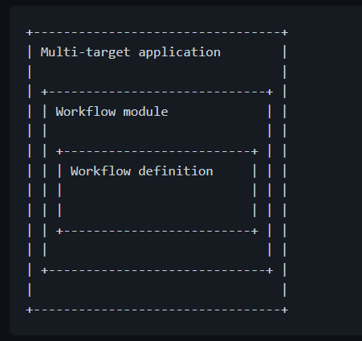
Initialize workflow module
Create a new multi target module project from template (welcome page)
Use F1 or choose View ➔ Find Command and select Open Template Wizard
Choose the template as @workflow/workflow
Provide the folder location of mta.yaml file
Enter the details of workflow module name, workflow name, description and choose create
A standard structure gets created.
A Multitarget application (MTA) is logically a single application comprised of multiple parts created with different technologies, which share the same lifecycle.
The developers of the MTA describe the desired result using the MTA model, which contains MTA modules, MTA resources, and interdependencies between them.
Afterward, the SAP BTP Deployment service validates, orchestrates, and automates the deployment of the MTA, which results in Cloud Foundry applications, services and SAP specific contents.
www.anubhavtrainings.com

Slide 30
Understand the workflow project structure
Forms folder which contains all the simple user interfaces, this constitutes a label and field pair.
Sample-data this folder contains our workflow data which needs to be circulated across all workflow steps. This data is always in JSON (Java Script Object Notation) format, and also known as context.
Scripts when we want to manipulate data during the workflow processing for imperative logic (if, looping, checks, calculation, manipulations) we need to use java script programming (js), these reusable files will be stored inside scripts folder
Webcontent this contains complex user interfaces, we use sap ui5 technology to develop these interfaces
Workflows this is the folder for all our workflows, which contains sequence of steps to automate business process. All the workflows have an extension called .workflow
Project name
Workflow module
forms
sample-data
scripts
webcontent
workflows
Anubhav.workflow
mta.yaml
Root directories
Project directories
www.anubhavtrainings.com
Files

Slide 31
Use of mta.yaml file
Multitarget Applications are defined in a development descriptor required for design-time purposes.
The development descriptor (mta.yaml) defines the elements and dependencies of a Multitarget Application (MTA) compliant with the Cloud Foundry environment. We can use a graphical editor provided by SAP to edit the application descriptor file.
When we want to package OR deploy our workflows to BTP, all the dependencies and module information will be provided by this file to the cloud foundry runtime.
We can package our project by describing all the details in this file and choose Build MTA project.
www.anubhavtrainings.com

Slide 32
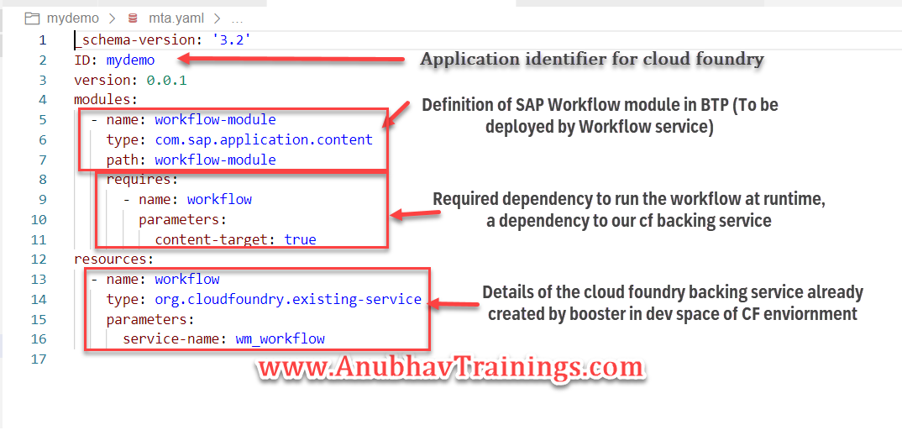
Service binding with workflow service
In order to deploy our workflow to cloud foundry we need a backing service named as workflow, this service is responsible for deployment and execution of workflow in BTP cloud foundry environment and a must.
Since we executed booster, the service was already created by system so we will change file to adapt to already created service instance.
www.anubhavtrainings.com

Slide 33
Workflow Context
The workflow context contain data that can also be represented using the JavaScript Object Notation (JSON). This is helpful to propagate and store data related to workflow instance through out the execution. We can compare workflow context with containers in ECC workflows.
The workflow context can be initialized at the start of the cloud workflow and in the middle of the execution, we can read/edit the context information based on the requirement.
The workflow context cannot store:
Functions
Prototype objects
Special numbers, such as NaN (Not a Number), positive infinity, or negative infinity
www.anubhavtrainings.com
Notes:
https://help.sap.com/docs/WORKFLOW/e157c391253b4ecd93647bf232d18a83/36fa9a00893f42939fa17516a33f2a94.html

Slide 34
Workflow Task Types
User Task – where a manual decision is required by agent like approval or rejection of leave request
Service Task – just want to invoke the communication to a system via service call
Script task – we can write code to manipulate the workflow context, call the wf apis at runtime (JS code)
Mail task – configure, design and send an email
Embedded – To integrate another sub workflow inside main workflow, used for modularization
www.anubhavtrainings.com
Notes:
https://help.sap.com/docs/WORKFLOW/e157c391253b4ecd93647bf232d18a83/36fa9a00893f42939fa17516a33f2a94.html

Slide 35
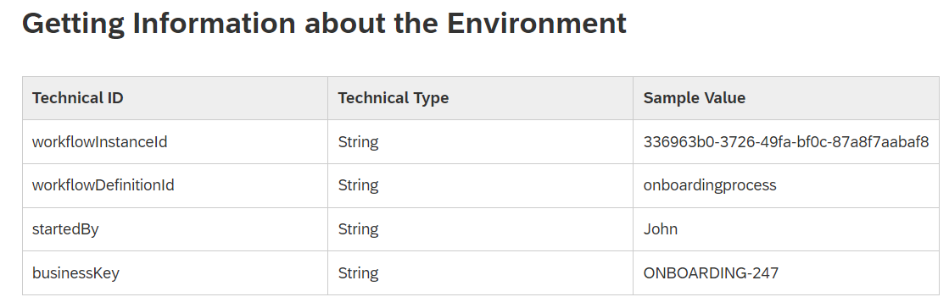
Workflow Context Access
We can access the workflow context data using - ${context.objectname}
We can also modify the context data during runtime of script task using - $.context.objectname
There are also standard context variable
www.anubhavtrainings.com

Slide 36
Deploy the workflow
We need to build and deploy our workflow to cloud foundry environment using mta.yaml file.
We will repeat the process using cloud foundry plugin.
www.anubhavtrainings.com

Slide 37
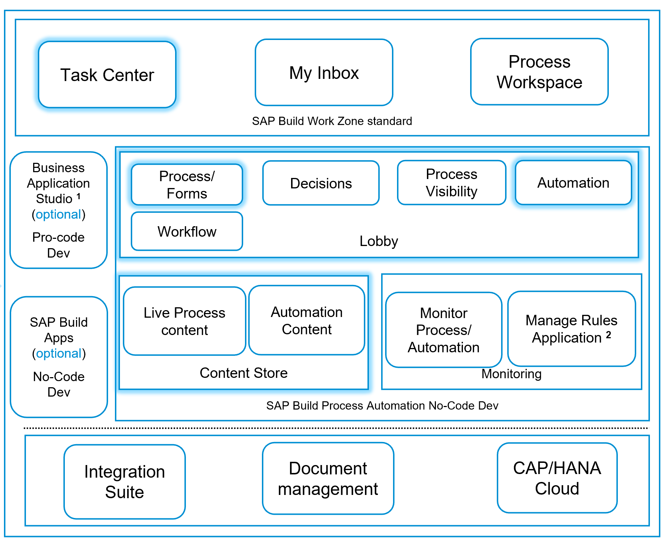
SAP Workflow management – big picture
www.anubhavtrainings.com

Slide 38
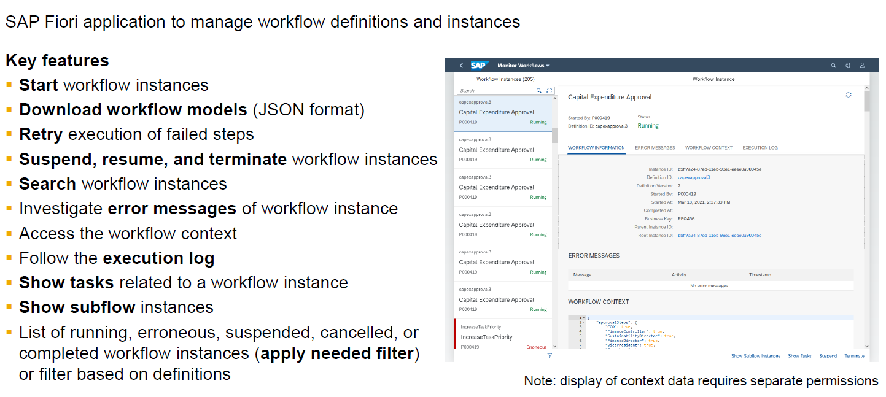
Monitor Workflow
Content
www.anubhavtrainings.com

Slide 39
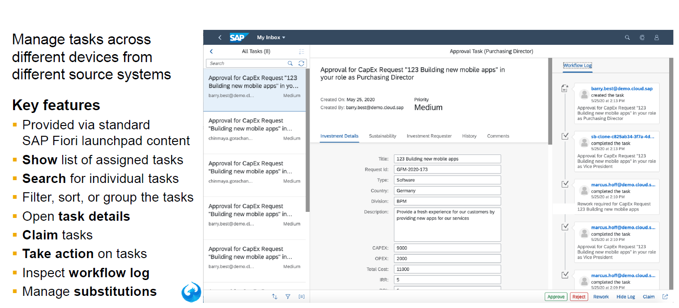
My Inbox - Features
Content
www.anubhavtrainings.com

Slide 40
Setup the ES5 demo system
An account on the SAP NetWeaver Gateway Demo system "ES5“ for the purpose of integration with workflow
Sign up here and then ensure your account is active and the username and password are correct, by checking you can access HTTP-based services such as
the EPM_REF_APPS_SHOP_SRV OData service.
If you find that you've forgotten your credentials for the ES5 system, you can visit the ES5 account administration page to get your password reset.
User id ES5 - P2005641460
www.anubhavtrainings.com

Slide 41
Create new destination
Go to your "Trial Subaccount Home" page, and select the "Destinations" menu item within the "Connectivity" item.
Select the "New Destination" option, and in the configuration specify values for the appropriate parameters. Some values will depend on whether you have successfully completed the previous exercise and set up the SAP Cloud Connector or not, so the entire value set is presented twice, covering both scenarios. Use the values for your scenario.
Property | Value
Name | AnubhavDestination
Type | HTTP
Description | Anubhav ES server
Location ID | (leave blank)
URL | https://sapes5.sapdevcenter.com:443/sap/opu/odata/sap/EPM_REF_APPS_SHOP_SRV/
Proxy Type | Internet
Authentication | BasicAuthentication
User | (your ES5 username)
Password | (your ES5 password)
Property | Value
sap-client | 002
www.anubhavtrainings.com

Slide 42

Server Access & Connectivity
www.anubhavtrainings.com

Slide 43

Workflow Scenario - 2
Design and develop a workflow to read Product data from E-Shop OData service from ES5 demo system.
/sap/opu/odata/sap/EPM_REF_APPS_SHOP_SRV/Products('HT-1000')?$format=json&$expand=Reviews
www.anubhavtrainings.com

Slide 44
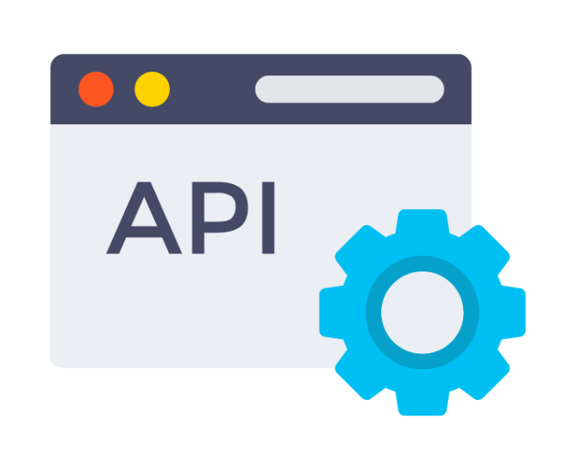
What is an API
API stands for Application Programming Interface, It is a end point, single point of contact for communication to data of a system and perform different kind of operations like create, read, update, delete, path, (CURDQ)
www.anubhavtrainings.com

Slide 45
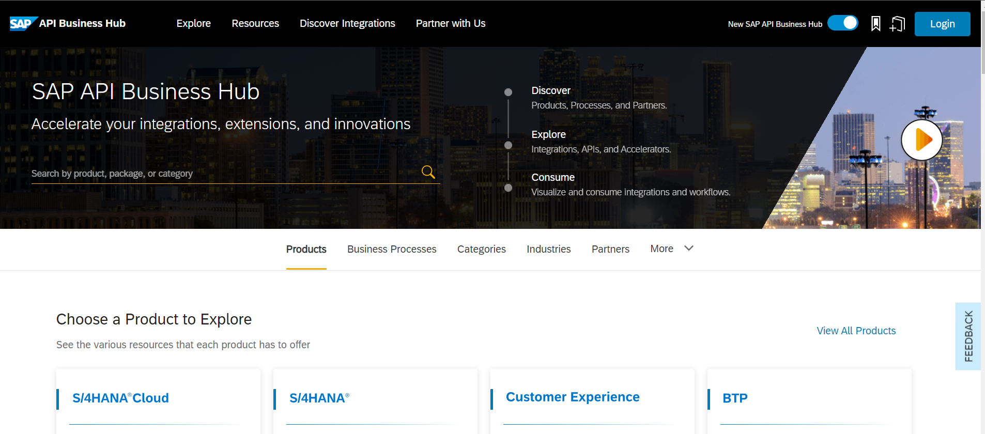
API HUB introduction
SAP Cloud Platform API management provides simple, scalable and secure access to digital assets through application programming interfaces (APIs) and enables developer communities to consume these. Key capabilities. Ÿ Unified standards-based API access of REST/OData or SOAP. services.
The SAP API Business Hub is a web application hosted by SAP to discover, explore, and test SAP and partner APIs (application programming interfaces) that are required to build extensions or process integrations. It also hosts Integration content, Events, CDS views, and more.
www.anubhavtrainings.com

Slide 46
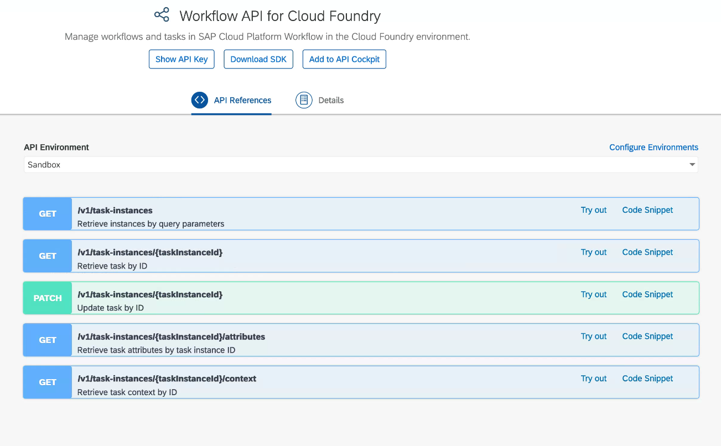
Build Process Automation API
The workflow API documentation helps us understanding the end points and sample payload to integrate cloud workflows with third-party and native SAP solutions. It describes the different aspects that the API covers, such as:
User Task Instances
Workflow Definitions
Workflow Instances
Forms
www.anubhavtrainings.com

Slide 47
Start workflow instance from API HUB Sandbox
We will first explore the service key generated out of our workflow deployment and then use properties here.
Specify the following values, noting that the Starting URL selection should reflect the value of the endpoints.workflow_rest_url property, including the particular region:
Property | Value
Starting URL | the value of endpoints.workflow_rest_url
Display Name for Environments | AnubhavAPISandbox
OAuth 2.0 Client Id | the value of uaa.clientid
OAuth 2.0 Secret | the value of uaa.clientsecret
consumersubdomain | the most significant hostname part of the fully qualified domain name value of uaa.url
landscapehost | the rest of the fully qualified domain name value of uaa.url, excluding the 'authentication' part
Apply this environment to all APIs in this package that are not yet configured | checked
Save this environment for future sessions | selected
the value of uaa.url is
https://757589e9.authentication.eu10.hana.ondemand.com
the value of "consumersubdomain" should be 898789e9trial
the value of "landscapehost" should be eu10.hana.ondemand.com
the resulting "Token URL" should be
https://757589e9trial.authentication.eu10.hana.ondemand.com/oauth/token
www.anubhavtrainings.com

Slide 48
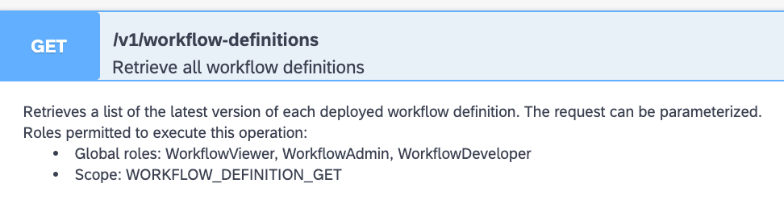
Understanding Security of Cloud Foundry APIs
For many services, API usage is protected by scopes, also known as authorities. These scopes are relevant when using an authenticated connection in the context of an OData 2.0 client credentials grant type.
In other words, authorities come into play (to "authorize" a call) when the authentication is connected directly to the instance. When an instance of a service is created, there may be some default scopes included, but it's always best to be explicit and specify the scopes that you'll require.
APIHUB (client) - POSTMAN
XSUAA
Workflow API
CF Workflow instances
Check authenticated
JWT token
Check scope
Read workflow instances/start/stop…
www.anubhavtrainings.com

Slide 49
Inject and Test scope
Since an instance of workflow service was created as part of a larger process, like in the booster case in an earlier exercise, you can update the service instance and add the scopes manually.
Check cf target if we already login to cloud foundry or not, if not use cf login
Find the list of all the services cf services
Issue command to inject the scope to workflow service
cf update-service sap_processautomation -c '{"authorities": ["ProcessAutomationAdmin"]}'
The value supplied with the -c command option is in JSON format, make sure you use the right combination of quotes and brackets. Happily, as we're all using a Linux based Bash shell courtesy of the App Studio, there are no variations to worry about here!
5. Test the APIs again from API HUB
GET /v1/workflow-definitions
POST /v1/workflow-instances
{
"definitionId": "orderprocess",
"context": {
"request": {
"Id": "HT-1002",
"Quantity": 42
}
}
}
www.anubhavtrainings.com

Slide 50
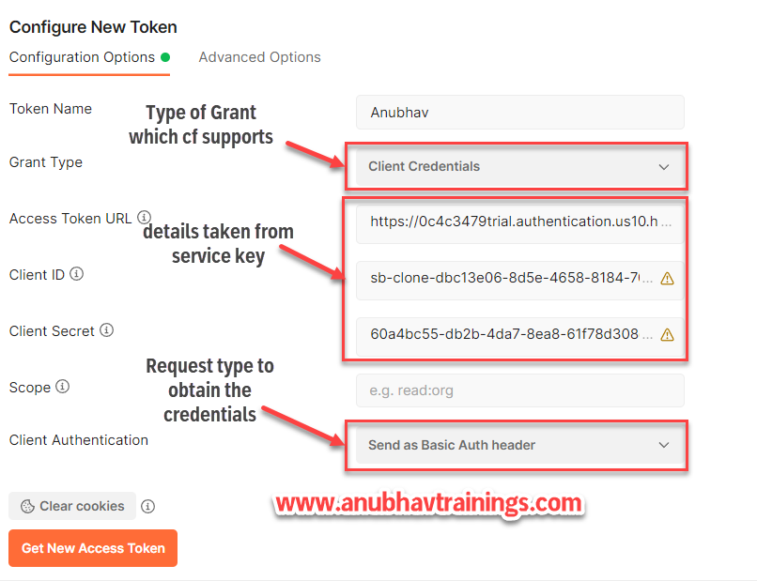
Calling the API from Postman with Bearer
www.anubhavtrainings.com

Slide 51
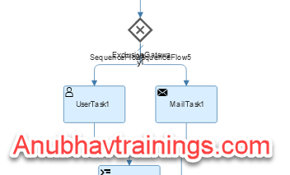
Gateways in workflow
A gateway controls the flow of execution and is represented visually as a diamond shape with an icon inside. The icon shows the type of gateway.
The workflow capability editor supports the following gateway types:
● Exclusive gateway: Use an exclusive gateway to model a decision in the process. When the execution arrives at this gateway, all outgoing sequence flows are evaluated in the order in which they’re defined. The sequence flow with a condition that evaluates to true is selected to continue the process.
If multiple sequence flows have a condition that evaluates to true, the first one defined is selected to continue the process. If none of the conditions defined for the sequence flow evaluate to true, then the one marked as default flow is selected and the execution proceeds along that path.
www.anubhavtrainings.com

Slide 52
Gateways in Workflow
●Parallel gateway: Use a parallel gateway to split into multiple paths of execution or merge multiple incoming paths of execution. The functionality of the parallel gateway is based on the following incoming and outgoing sequence flow:
Split: All outgoing sequence flows are executed in parallel; there’s one concurrent execution for each sequence flow.
Join: All concurrent executions arriving at the parallel gateway wait in the gateway until an execution has arrived for each incoming sequence flow. Then the process continues past the joining gateway.
A parallel gateway works on a logical level. It doesn’t speed up the technical execution.
For example, consider a scenario where an employee approaches the travel desk to book a flight and accommodation for a business trip. With a parallel gateway, both the flight arrangement and the hotel accommodation can happen in parallel. Once the booking is successful, an e-mail notification can be sent to the employee.
www.anubhavtrainings.com

Slide 53
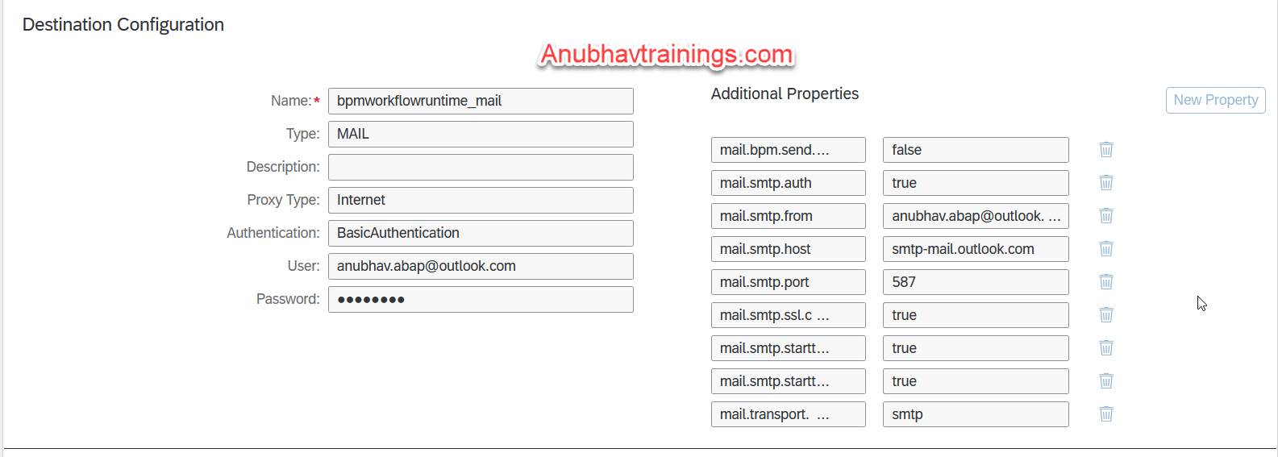
Configure Email
Before you can send notification mails for mail tasks within a workflow, you must first configure a mail destination.
Refer the documentation as below for destination creation
https://help.sap.com/docs/WORKFLOW/f85276c5069a429fa37d1cd352785c25/a24a9482314344f780e48f3195597cb2.html
www.anubhavtrainings.com
Notes:
https://help.sap.com/docs/WORKFLOW/f85276c5069a429fa37d1cd352785c25/a24a9482314344f780e48f3195597cb2.html

Slide 54

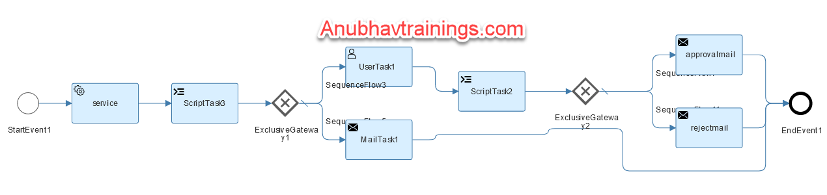
Workflow Use Case 3
Alex is a manager working in one of the top IT Company. He is being approached for every shopping cart request created by employees reporting to him. His key requirements are
Design a workflow to automate the shopping cart for products
He want an approval only if the product cost is above 100 USD
If the product cost is less than 100 USD the shopping cart should approve automatically
On approval (or auto-approval) or rejection, an email should trigger to creator
If Alex do not take action on shopping cart request for more than 5 minutes, we should cancel the workflow
Cheat sheet workflow expressions
https://help.sap.com/docs/WORKFLOW/e157c391253b4ecd93647bf232d18a83/9f91b1c0fac3414d9cba1015dea381f1.html
www.anubhavtrainings.com
Notes:
/sap/opu/odata/sap/EPM_REF_APPS_SHOP_SRV/Products('${context.id}')?$format=json
$.context.val = parseInt($.context.response.d.Price);
if(parseInt($.context.response.d.Price) > 100){
$.context.status = true;
}else{
$.context.status = false;
}
var lastUserTask1 = $.usertasks.usertask1.last;
$.context.subject = lastUserTask1.subject;
$.context.processor = lastUserTask1.processor;
$.context.doneOn = lastUserTask1.completedAt;
$.context.status = lastUserTask1.decision;
${context.status == true}
${context.status == "approve"}
{
"id": "HT-1000",
"response": ""
}

Slide 55
Title
Content
www.anubhavtrainings.com

Slide 56
Title
Content
www.anubhavtrainings.com

Slide 57
Title
Content
www.anubhavtrainings.com

Slide 58

What We Did
Let’s Summarize

Slide 59

www.anubhavtrainings.com
Thank You
End of Day 1

Slide 60



We’re committed to empower you to be
#FutureReady
through powerful training solutions.
We build the workforce of the future.
250+
Corporate Clients
30,000+
Learners Trained
25000+
Learners Placed
FREE WEBINARS
Sign up for free webinars with industry experts every fortnight!
Enroll Now!
Contact us today!
https://anubhavtrainings.com

